Slide 1
Internet Traffic Data Time series Analysis
By
Anirudha Deepak Bedre
Guruprasath
Balamanikandan Gopalakrishnan
Vijayakumar Jayaseelan

Slide 2
Agenda
Introduction
Exploratory Data Analysis
Inference and Recommendations
Prediction – Time series Forecasting

Slide 3
Introduction
Data Set
The internet data of an ISP consumed in 11 European cities for a period of two months collected at a 5 minute interval
Objectives
Perform exploratory data analysis to understand data
Identify key usage metrics such as trend and seasonality
Optimize the network usage and ensure availability
Recommend solutions to improve business
Predict internet traffic with minimal error

Slide 4
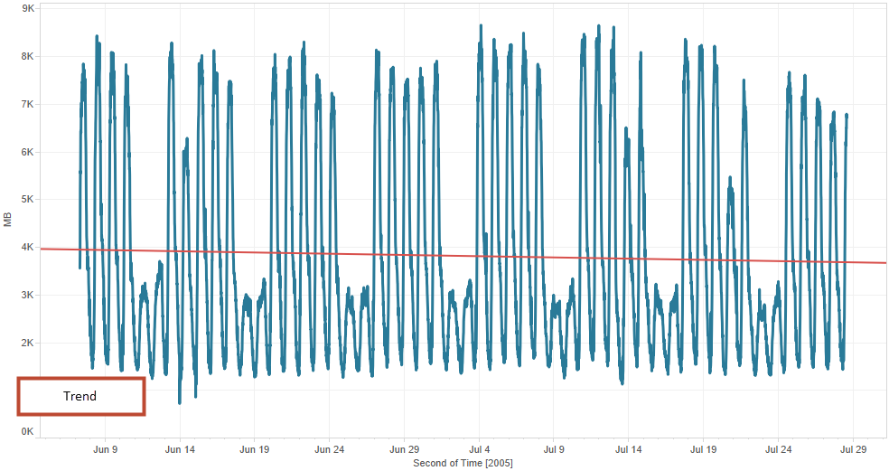
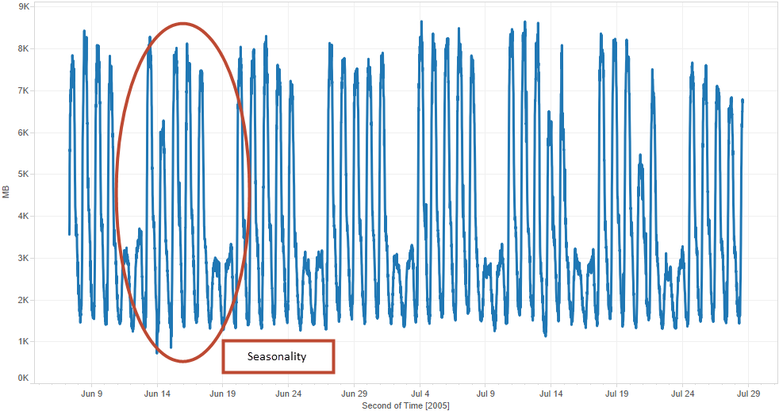
Data Analysis – Trend & Seasonality

Slide 5
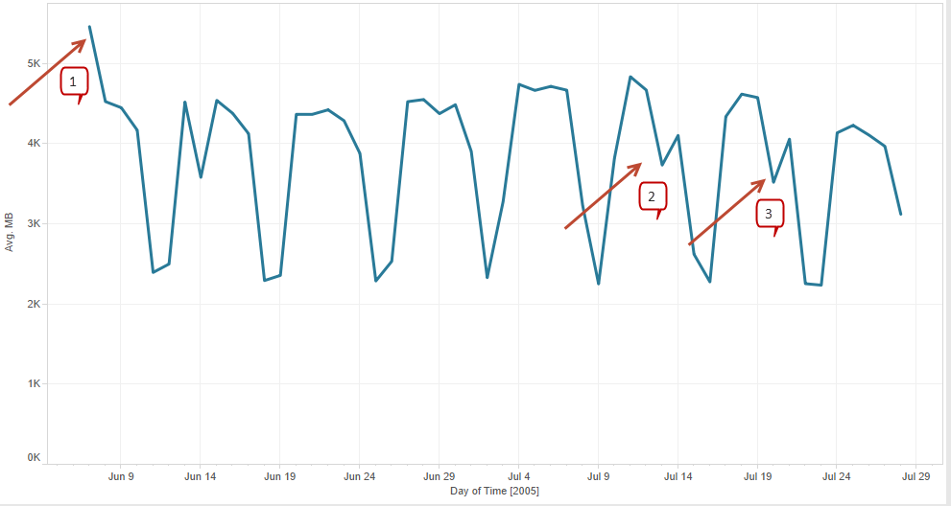
Data Analysis – By Day
Anomalies
General Elections
Harry Potter and the half blood prince book release
Bomb blast in Europe

Slide 6
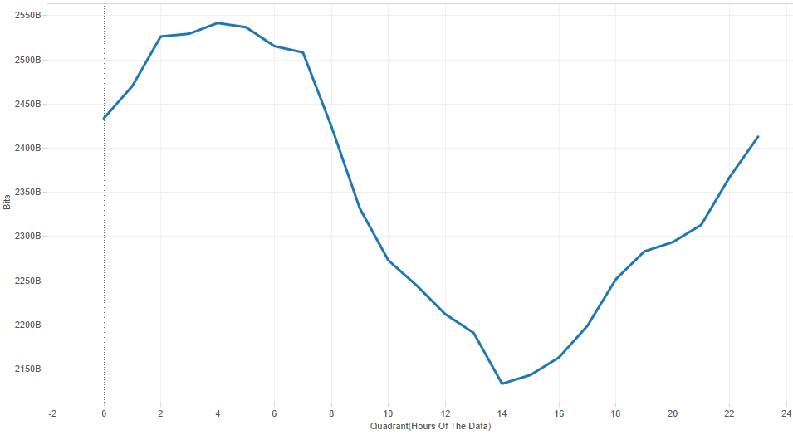
Data Analysis – By Hour
The usage is observed to be more during non business hours

Slide 7
Insights & Inference
The network was generally used during non-business hours
The network traffic was high during weekdays
The behavior of internet usage on an hourly basis shows that the data consumed early in the morning and late at nights is high due to the fact that ISP providers used Dial-up modems at that time which could only have either telephone or internet at any given time.
Recommendations
Promotional offers could be introduced during business hours and weekends to boost the network usage
Failovers could be performed during afternoons to reduce operational costs

Slide 8
Prediction

Slide 9
Holt-Winters Smoothing

Slide 10
Training – Rollup by Quarter(of an hour)
RMS Error: 1944 MB

Slide 11

Time Series Analysis
Forecast using trend and seasonality
Auto correlation on Residue and identify appropriate lag
Aggregate the forecast and residue from ARIMA
ARIMA on Residue using selected lag
Forecast using trend, seasonality and selected lag

Slide 12
Training Forecast: F(t+9) + E(t+9)
RMS Error: 87 MB

Slide 13
Test Forecast
RMS Error: 137 MB

Slide 14
Final Model
RMS Error: 75 MB

Slide 15
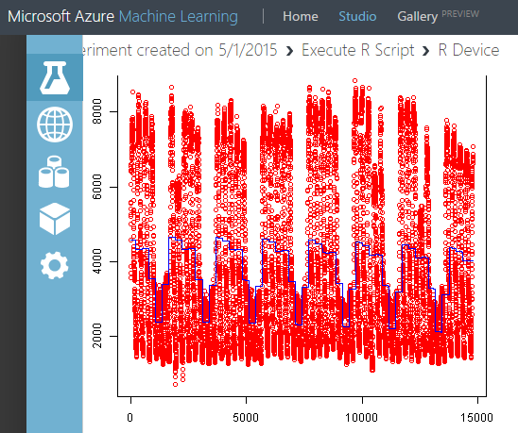
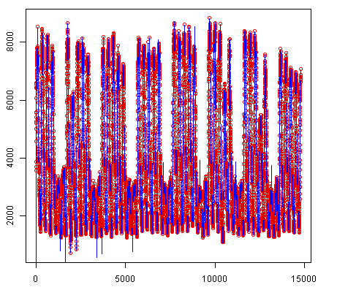
Final Model with R script in Azure

Slide 16


